Slide 1
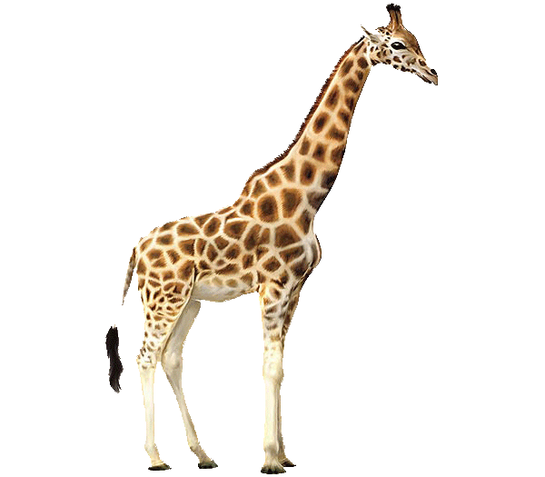
Physical description
Basic 05 – Unit 1 Lesson B

Slide 2
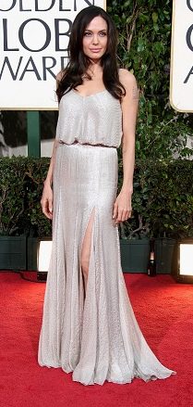
What does she look like ?
She has long straight brown hair.
She has green eyes.
She is in her (late) 30’s.
She is average height.
She is thin.

Slide 3
Describing People
BE + ADJECTIVE
BE + PREPOSITIONAL PHRASE
HAVE + (ADJECTIVE) NOUN
Chris is tall.
I am thin.
Lucy is in her teens
He has brown eyes.
We have black hair.
John has long hair.

Slide 4
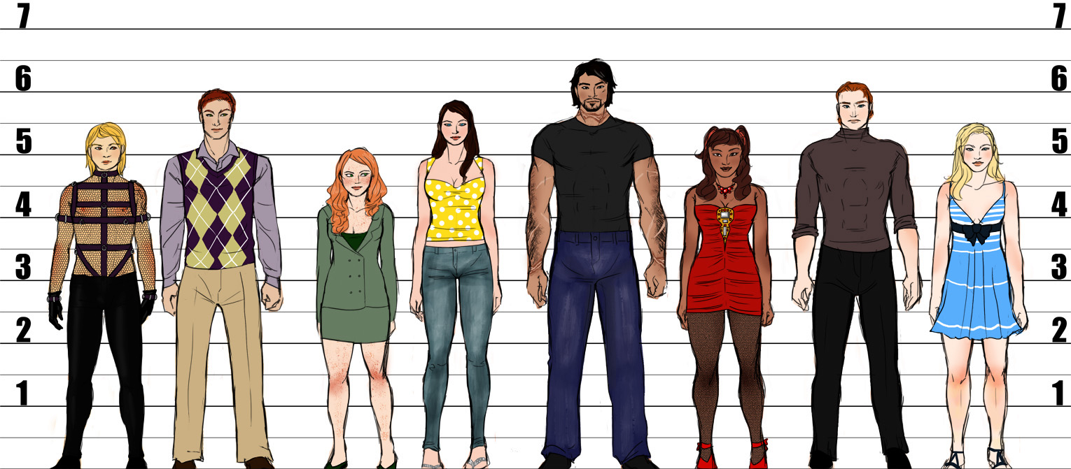
Height
Short? Average height? Tall?

Slide 5
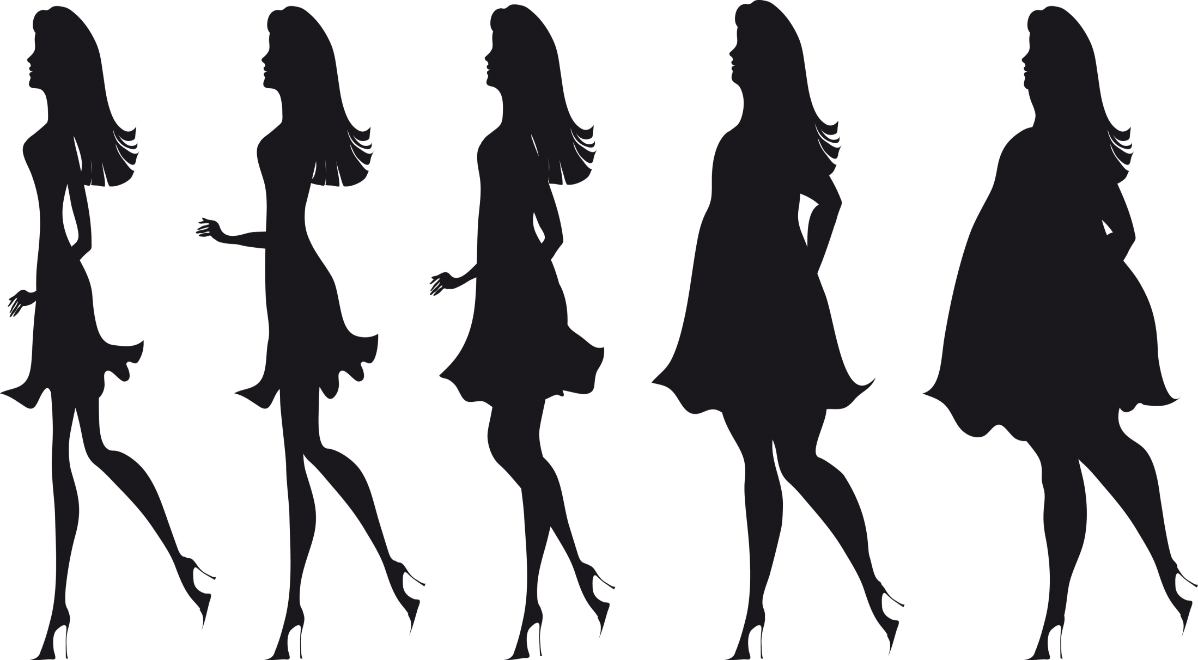
Weight
Thin
Slim
Average weight
Heavy set
Over weight

Slide 6
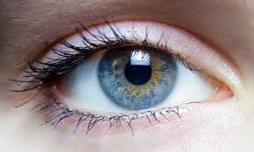
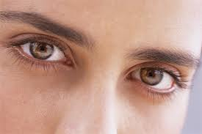
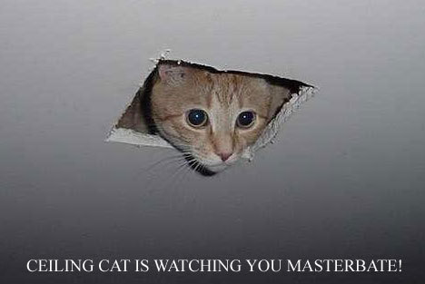
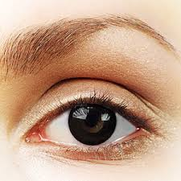
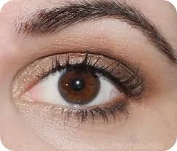
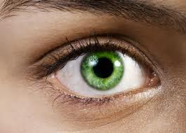
Eye Color
Blue eyes
Light brown eyes
Black eyes
Brown eyes
Green eyes

Slide 7
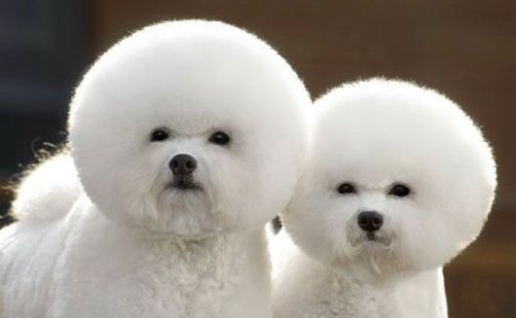
He has blond hair.
He has brown hair.

Slide 8
He has black hair.
He has red hair.
He has gray hair.

Slide 9
She has curly hair.
She has wavy hair.
She has straight hair.

Slide 10
He has a shaved head.
He is shaved.
He has short hair.
He has long hair.

Slide 11
He has a shaved head.
He is shaved.
He’s bald.

Slide 12
AGE
How old are you ?
How old is he ?
How old is she ?
How old are they ?

Slide 13
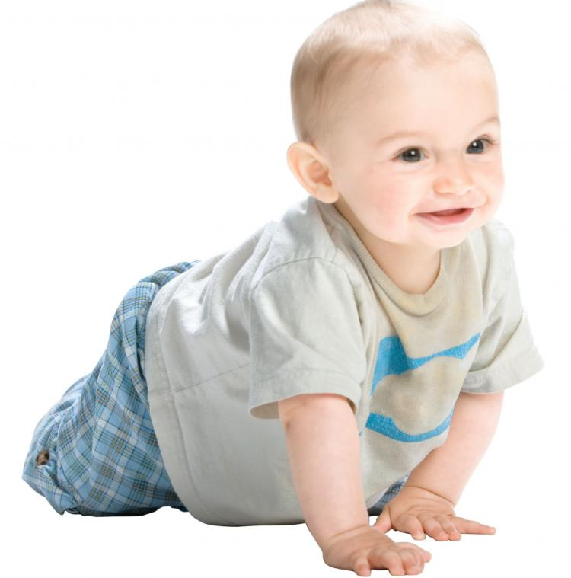
He is very young.
He is a baby.

Slide 14
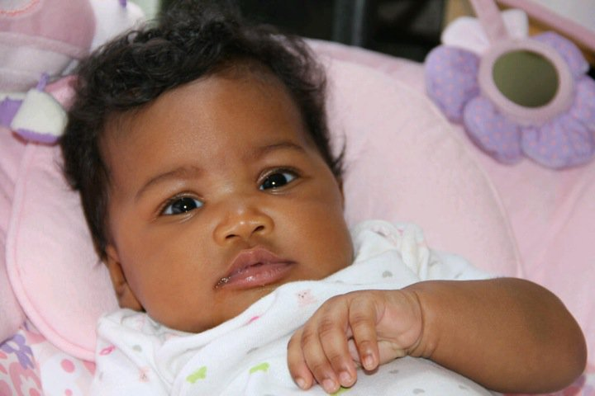
She is very young.
She is a baby.

Slide 15
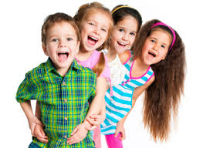
They are young.
They are children.

Slide 16
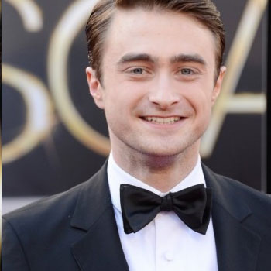
He is in his twenties.
Who is he ?
He is Daniel Radcliffe
How old is he?
He is in his twenties.

Slide 17
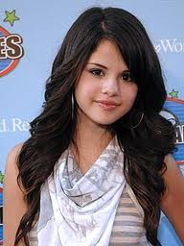
She is in her twenties.
Who’s she?
She’s Selena Gomez.
How old is she?
She is in her twenties.

Slide 18
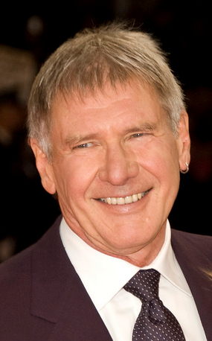
He is in his sixties.
Who is he?
He is Harrison Ford.
How old is he?
He is in his sixties. .

Slide 19
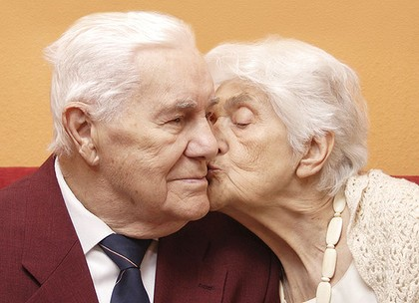
They are elderly people.
They are in their nineties.

Slide 20
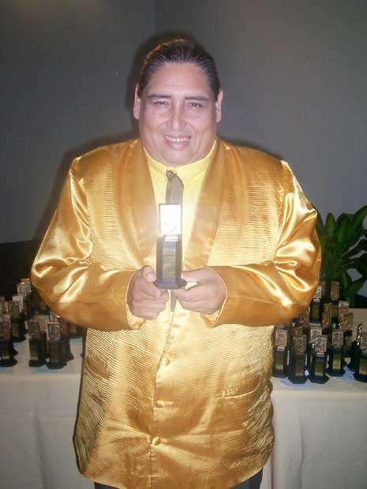
What does he look like ?
He has long straight black hair.
He has black eyes.
He is in his 50’s
He is average height
He is heavy set.

Slide 21
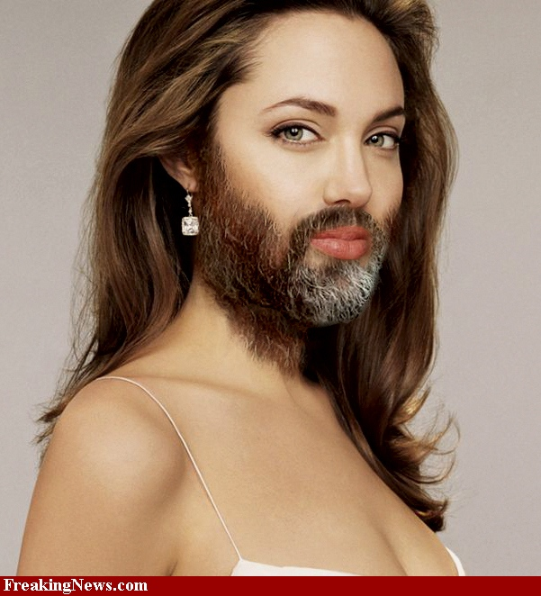
What does she look like ?
She has long wavy brown hair.
She has green eyes.
She is in her 30’s
She is average height
She is average weight
She has a beard.
She has a mustache.

Slide 22
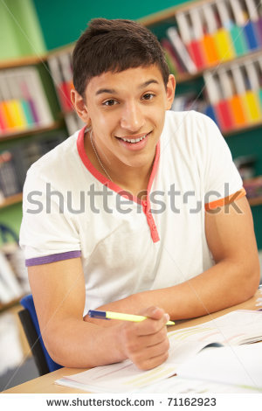
What does he look like ?
He has short straight light brown hair.
He has brown eyes.
He is young / He is in his teens
He is average height
He is average weight

Slide 23
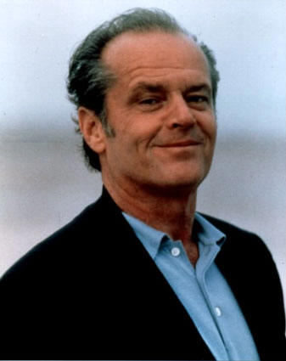
What does he look like ?
He has short straight gray hair.
He has brown eyes.
He is elderly / He is in his seventies
He is average height
He is average weight

Slide 24
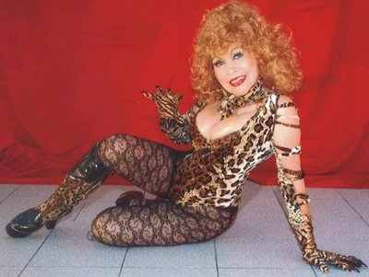
What does she look like ?

Slide 25
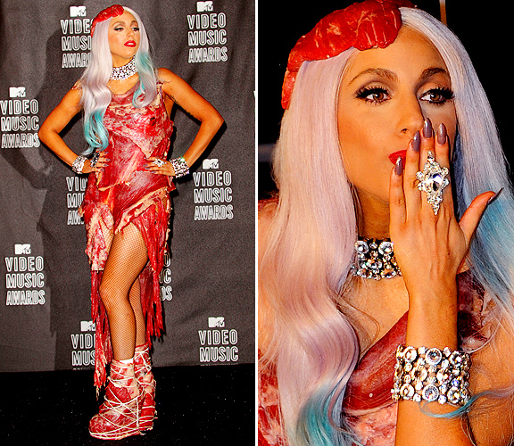
What does she look like ?

Slide 26
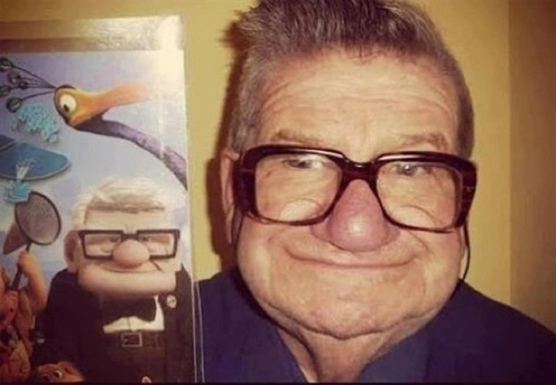

Slide 27
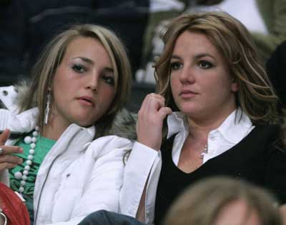
Does Britney look like her sister Jamie?
Yes, she does. She looks like her sister.

Slide 28
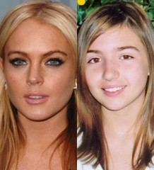
Does Linsay Lohan look like her sister?
No, she doesn´t. They look different.

Slide 29
Who does Britney look like?
She looks like her sister Jamie.

Slide 30
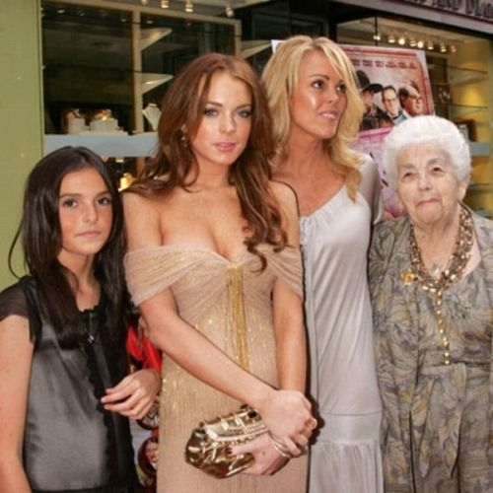
Who does Linsay look like?
She looks like her mother.

